Slide 1
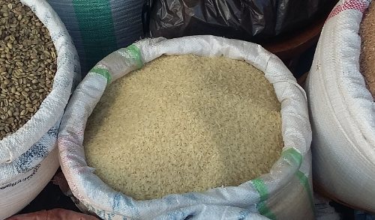
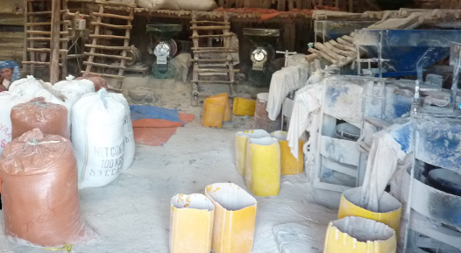
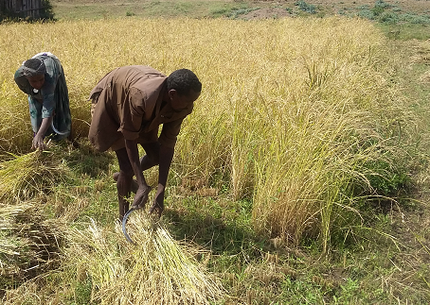


Rice Commercialisation, Agrarian Changes, and Livelihood Impacts in Ethiopia
29 November 2021
Rice Sector Transformation Event in Ethiopia
Lessons from the APRA Ethiopia Programme
www.future-agricultures.org/apra

Slide 2
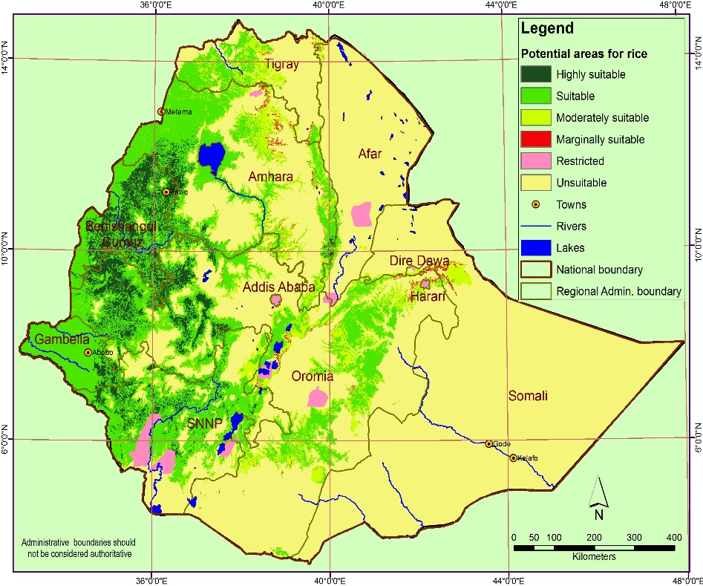
Content
APRA and its research in Ethiopia
Rice in Ethiopia
  Growing importance
  Trends in production, imports, consumption,
  Trends in rice R&D efforts
Key Challenges
Key Policy and Development lessons
www.future-agricultures.org/apra

Slide 3
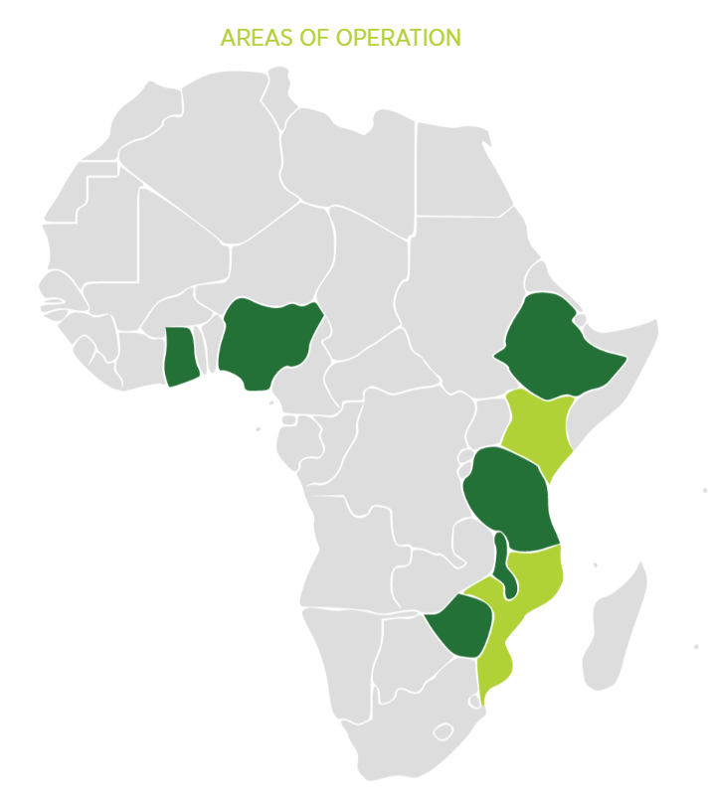
APRA and its research in Ethiopia
The Agricultural Policy Research in Africa (APRA) Programme is a six-year (2016-22) research initiative led by the Future Agricultures Consortium (FAC) and funded by the UK FCDO
APRA aim is to help inform future policy and investment decisions to promote inclusive forms of agricultural commercialisation in sub-Saharan Africa targeting six focal countries across east, west and southern Africa (Ethiopia, Ghana, Malawi, Nigeria, Tanzania, and Zimbabwe).
In Ethiopia, it aims to document the historical trends and dynamisms in the rice sector in relation to its commercialisation, livelihood options, and linkage in rural transformation
www.future-agricultures.org/apra

Slide 4
APRA and its research in Ethiopia
The most important research outputs are included in the event package
  Working papers
  Policy Briefs
  Research Notes
  APRA Ethiopia Research Brochure
Details of not only research outputs for Ethiopia but also for the other target African countries can be accessed at
Apra – Future agricultures (future-agricultures.org)
www.future-agricultures.org/apra

Slide 5
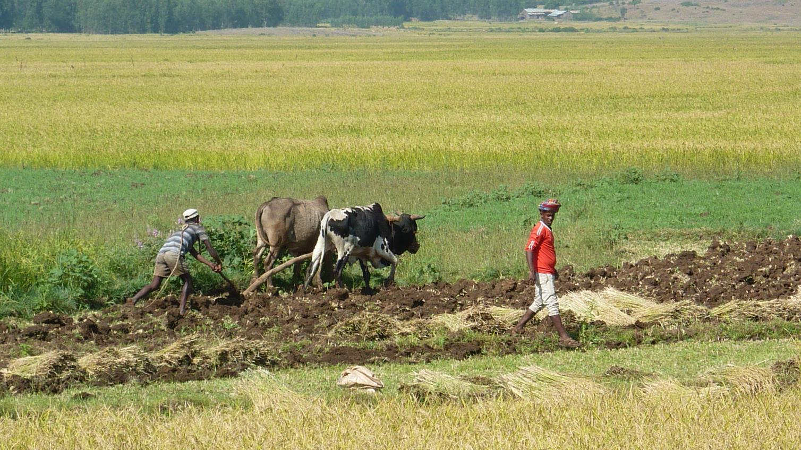
Importance of rice in Ethiopia
www.future-agricultures.org/apra

Slide 6
Rice in Ethiopia
Rice is a recent introduction to Ethiopia – linked with efforts to address development challenges during the Derge regime (e.g. food security, settlement)
Government has now designated 7 regions as ‘National Rice Hubs’ for Rice R&D
The Fogera area is one of those Hubs and has become a major rice producing zone with increasing levels of commercialisation
www.future-agricultures.org/apra

Slide 7
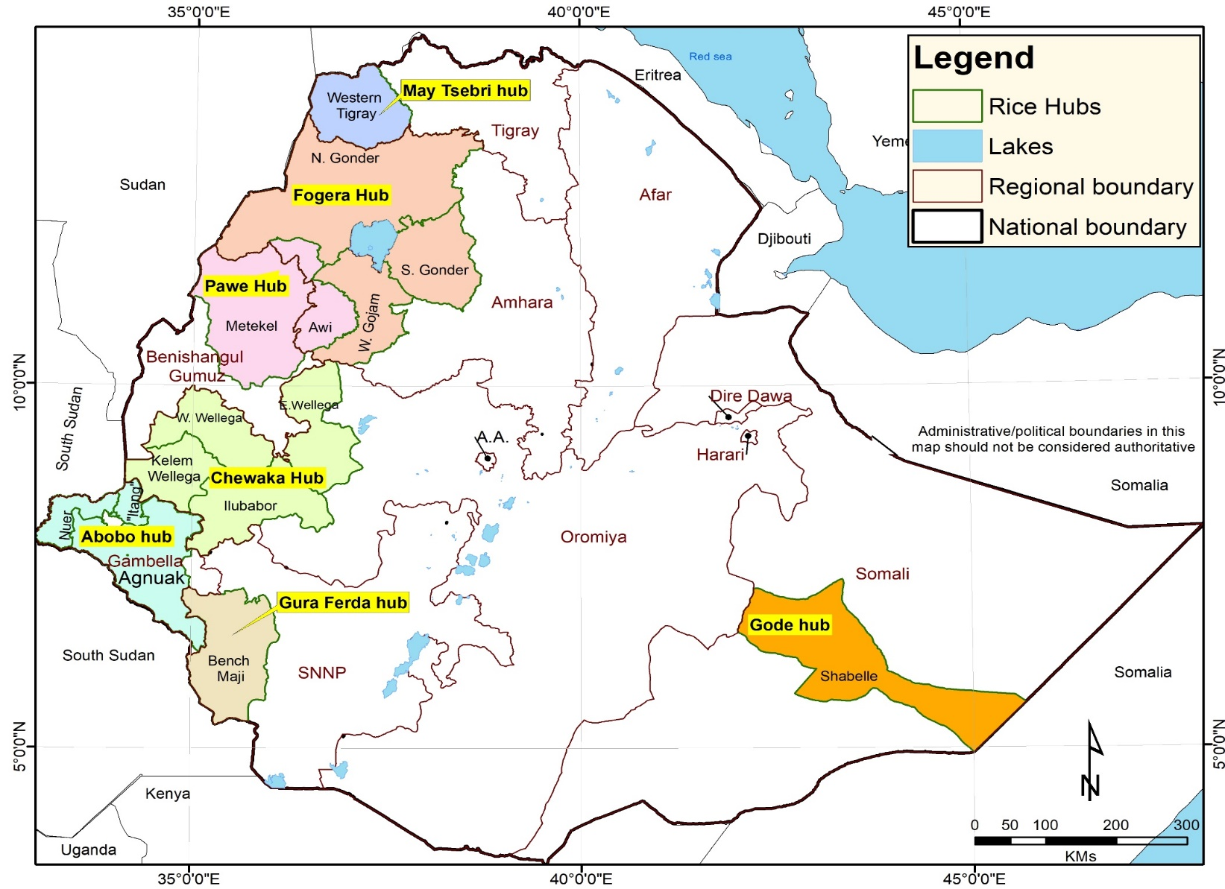
Rice in Ethiopia
www.future-agricultures.org/apra

Slide 8
Importance and comparative advantage
The importance and comparative advantage of rice is associated with the:
Existence of suitable agro-ecologies for increased production and the quest for addressing food insecurity and efficient utilisation of available resources
Compatibility of rice with local farming systems and traditional foods, especially injera making
Economic incentives of its production, related to higher productivity in response to high unit price
Enhancing inclusive agrarian changes (social inclusion, rural-urban linkage, rural labour market etc)
Favourable public policy environment and support of development partners (Government, JICA/EthioRice, CARD, AfricaRice, IRRI, etc)
www.future-agricultures.org/apra

Slide 9
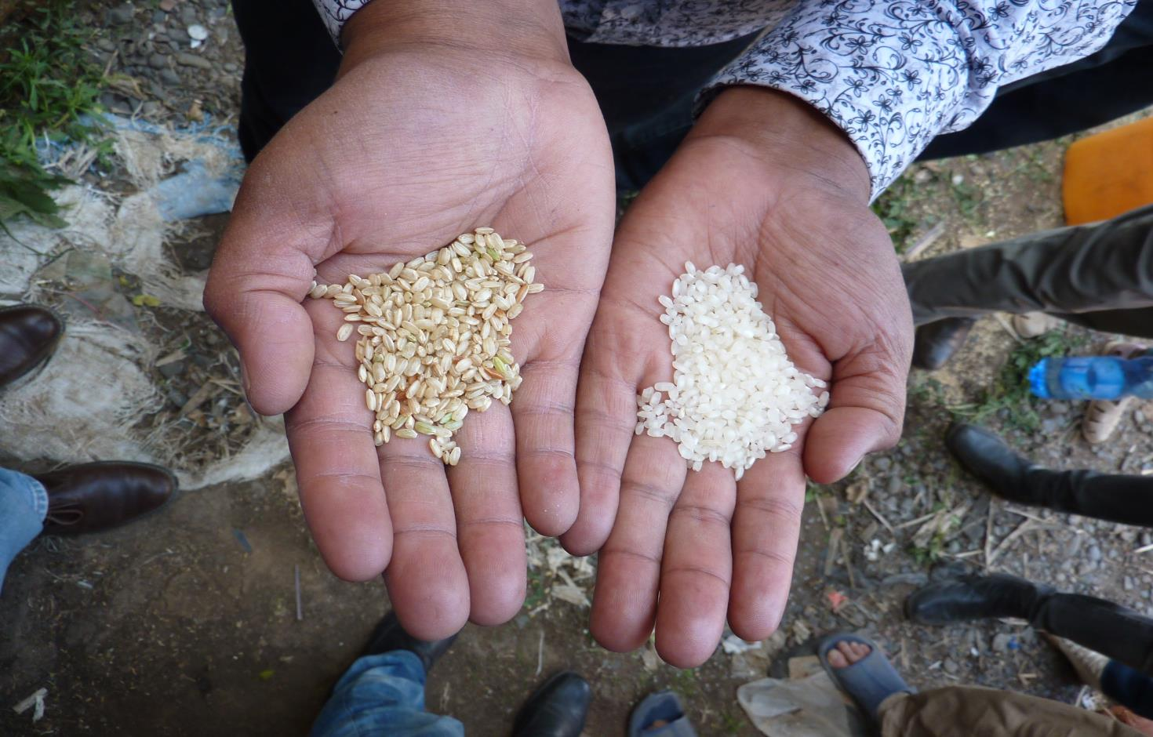
Trends in rice production, imports and domestic consumption
www.future-agricultures.org/apra

Slide 10
Trends in rice production, imports and domestic consumption in Ethiopia
Rice production increased by nearly 44%: ∼ 72 thousand Mt in 2008 → ∼ 270 thousand Mt in 2019/20 (CSA data)
But rice imports also increased by almost 14x over the same period (∼ 23 thousand Mt → ∼ 400 thousand Mt) – at a cost of USD 12 mil in 2008 to close to USD 200 mil in 2019/20
The extent of rice self-sufficiency decreased – 70% in 2008 → 24% in 2019/20
This implies a significant increase in domestic consumption of rice, with demand continuing to rise
www.future-agricultures.org/apra

Slide 11
Trends in production, imports and self-sufficiency in rice (2008 – 2019)
www.future-agricultures.org/apra
Notes:
% Self-Sufficiency = Domestic Production / Total Consumption (Production + Import) x 100
What is driving rapid domestic consumption? Changing food preferences – injera being made from mixture of teff and rice
Huge potential to increase domestic production to meet growing demand
Data:
Import data from Customs Dept
Production data from CSA

Slide 12
Trends in production, imports and self-sufficiency in rice (2008 – 2019)
How to fill this growing gap?
www.future-agricultures.org/apra
Notes:
% Self-Sufficiency = Domestic Production / Total Consumption (Production + Import) x 100
What is driving rapid domestic consumption? Changing food preferences – injera being made from mixture of teff and rice
Huge potential to increase domestic production to meet growing demand
Data:
Import data from Customs Dept
Production data from CSA

Slide 13
Rice imports – a burden on foreign currency and a systemic risk
The import bills for rice reached close to 200 million USD in 2019 and is projected to increase in future
A substantial amount of the imported product is low-grade broken rice from Asia
Average proportion of imports – 2008-2018
Type of rice product | Average proportion of total rice product imported (%)
Milled Rice | 70.88
Broken Rice | 19.94
Husked (brown) rice | 2.14
Total Paddy rice | 6.91
Rice flour | 0.14
www.future-agricultures.org/apra
Notes:
There is an increasing trend of rice imports creating a huge burden on foreign currency reserves.

Slide 14
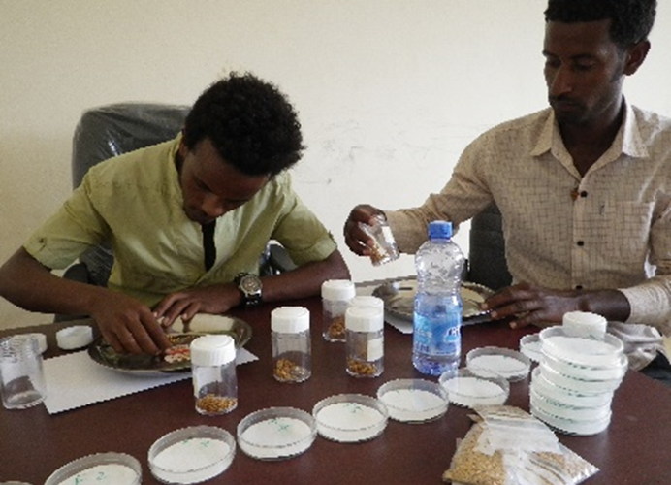
Trends in rice R&D efforts
www.future-agricultures.org/apra

Slide 15
Trends in Rice Research & Development
2007 – Rice is declared a ‘Millennium Crop’
2008 – Ethiopia joins CARD – the Coalition for African Rice Development (CARD)
2010 – The National Rice R&D Strategy is developed by the Government, with the support the Japanese International Cooperation Agency (JICA) and SG-2000
2010 – National Rice Steering and Technical Committees are established to guide implementation of the Strategy
2015 – EthioRice begins – EIAR-JICA cooperation project
2016 – Ethiopia joins AfricaRice (Africa Rice Center ) – a pan-African intergovernmental association of 27 member states
2017 – EIAR implements new Rice Research Strategy
2020 – revision of National rice strategy (2020 – 2030)
www.future-agricultures.org/apra

Slide 16


Intensifying Rice R&D
38 improved rice varieties have been released for three rice ecosystems
  21 for rain-fed uplands
  10 for rain-fed lowlands
  7 for irrigated lands (MoA 2019)
The National Rice Research and Training Center was established in Fogera in 2013 and formally inaugurated in 2018
www.future-agricultures.org/apra
Notes:
Major achievements:
To date, 35 improved varieties have been released – 15 rainfed upland, 11 rainfed lowland, 9 for irrigated
But need to know more about which varieties farmers prefer
Various location specific crop mgmt. technologies have been generated:
Agronomic fertiliser rate and application time; seed spacing; planting methods…
Future directions
Deal with crossing and hybridisation
More attention for irrigated rice – to improve expansion in irrigated regions
Market development variety development – including for export??
Strengthening ecosystem oriented research approach in the development of crop mgmt. technologies related to agronomy, cropping systems and crop protection
Ag mechanisation and food science research also needs to be strengthened
Integrated rice-livestock research (at least animal nutrition)

Slide 17
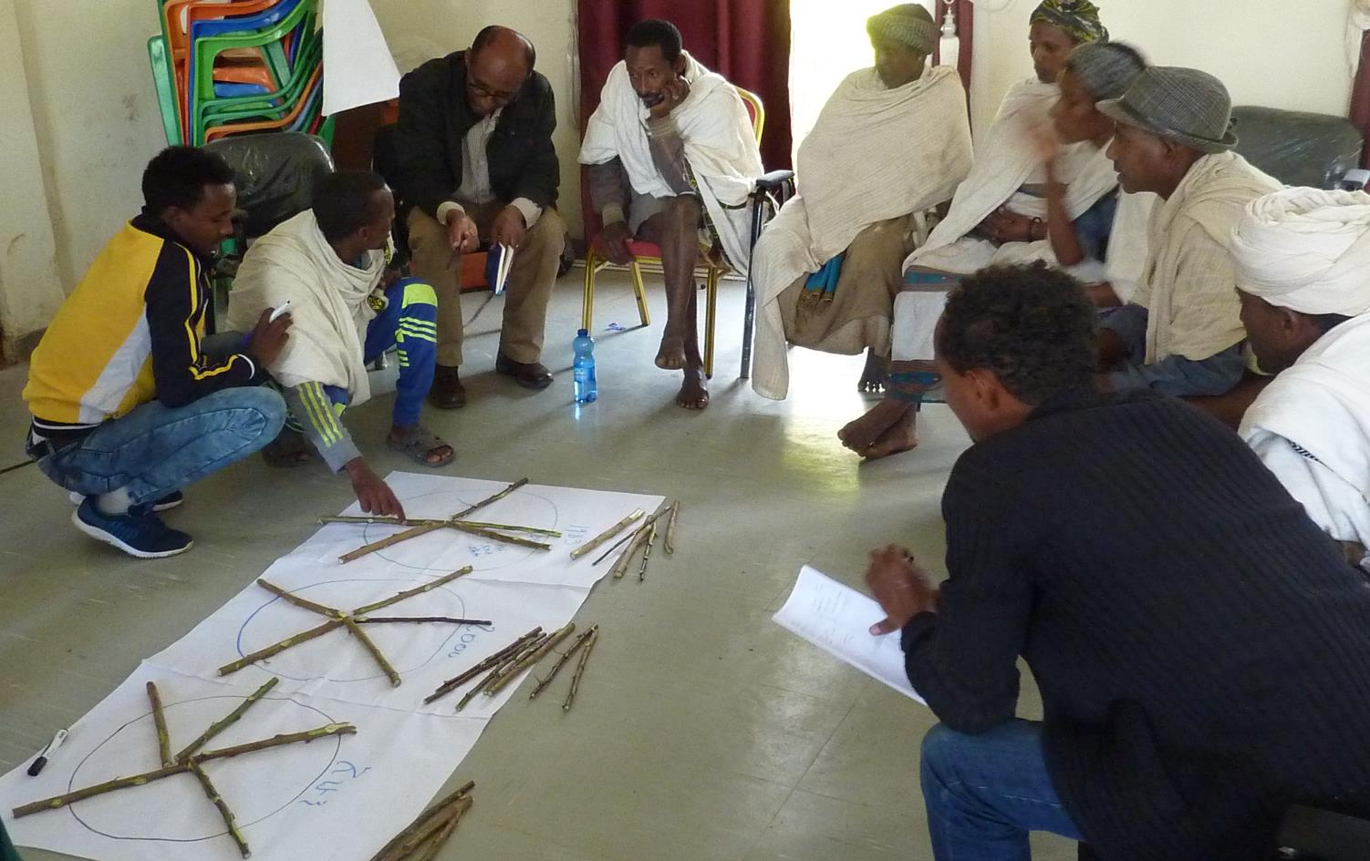
Key challenges facing the rice sector
www.future-agricultures.org/apra

Slide 18
Key challenges facing the rice sector
Rice production and productivity remains low – national average is only 2.96 Mt/ha (CSA 2019/20)
Huge competition of imported rice with domestic rice – hard to compete on quality
The limited expansion of the relative successes in inclusive agrarian changes in Fogera plain to other rice hubs - Social inclusion, rural-urban linkage, rural labour market etc)
Shortage of pre-harvest mechanisation and post-harvest processing technologies – milling, storage, transport, etc.
www.future-agricultures.org/apra

Slide 19
Key challenges facing the rice sector
Inadequate market development to link to both domestic and international value chains
Lack of skilled human resources and training resources in all aspects of the rice R&D
Rice commercialisation has caused a decline in the production of livestock and crops such as pulses, esp. in the lowland rice zones (Fogera plain).
www.future-agricultures.org/apra

Slide 20
Key Policy and Development lessons
The success of rice commercialisation in the Fogera plain leads to important policy and development questions:
  “Why are other areas in Ethiopia not as successful in this endeavour?”
  “Why are the levels of self-sufficiency continuously declining?”
The answer lies in the requirement to establish policies and associated funding for rice sector development
www.future-agricultures.org/apra

Slide 21
Key Policy and Development lessons
To ensure competitiveness and improve incomes for smallholder rice farmers, there is a need to:
  Address the challenges which arise from restrictive land and its use policy
  Ensure the competitiveness of local rice, both in terms of price and quality, compared to imported rice, through adequate research and development efforts
  Develop incentive mechanisms for farmers and agro-processors to produce quality rice
www.future-agricultures.org/apra

Slide 22
Key Policy and Development lessons
To ensure competitiveness and improve incomes for smallholder rice farmers, there is a need to:
  Modernise and build the capacity of rice processors and standardise the key requirements for the licensing of rice processing facilities;
  Improve the performance of marketing systems – not only for rice, but also for other crops (such as vegetables), which are the main contributors to smallholder rice farmers’ incomes.
  Design implementation strategy with strong M&E and learning and proper alignment all relevant stakeholders
www.future-agricultures.org/apra

Slide 23
Acknowledgment
Rice farmers, processors, labourers – for their time in participating in the interviews
Customs Authority, CSA, MoA, BoA – For providing required secondary data
National Rice Research and Training Center of EIAR – for facilitation of the different data collection events
Future Agricultures Consortium (FAC) APRA programme team – for all technical support
UK FCDO - for funded the programme
www.future-agricultures.org/apra

Slide 24
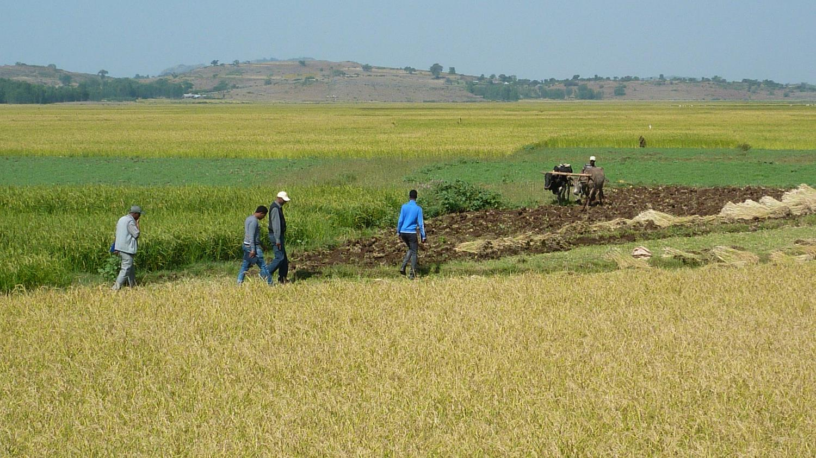
Thank you for your attention
Dawit Alemu
dawit96@gmail.com
www.future-agricultures.org/apra

