Slide 1
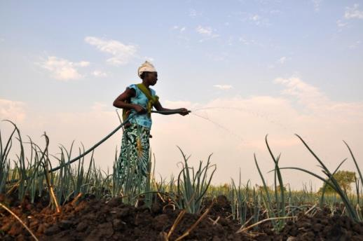
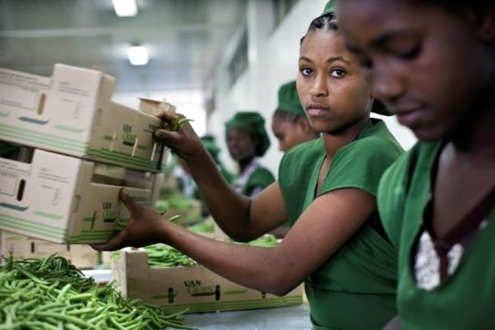
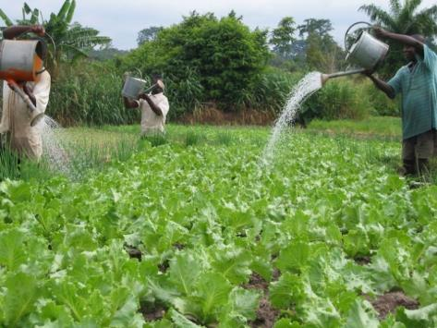





Rapid Assessment of the Impact of COVID-19 on Food Systems and Rural Livelihoods in Malawi
by
Mirriam Matita & Masautso Chimombo
(APRA Researchers Malawi)
11th November 2021
Funded by UK aid from the UK Government
www.future-agricultures.org/apra

Slide 2


Introduction
COVID-19 pandemic has caused disruptions to national and global economies
An impending ‘natural disaster’ (Lancet Global Health, 2020)
  Negative outcomes on poverty, hunger, malnutrition etc
  Greater impact among low and middle-income countries - SSA, including Malawi.
This is because even before the COVID-19 pandemic began populations struggling in these locations were high
Objective: To investigate the effects of COVID-19 on food systems and rural livelihoods
www.future-agricultures.org/apra

Slide 3
Methods
Mixed research methods
Study participants
  114 household heads/ their representatives
  8 key informant/experts
Sub sample of households participating in APRA wide study in Malawi in Mchinji and Ntchisi districts.
Selection of study sites based on their proximity to trading centres
3 rounds of data collection (June/July, Oct, 2020 & Feb 2021)
Round 1 (R1) was face to face and telephone interviews were used in R2 & R3
www.future-agricultures.org/apra
Notes:
APRA is investigating the pathways to commercialisation and its outcomes
Used semi-structured questionnaire & checklist
both qualitative and quantitative data was collected

Slide 4

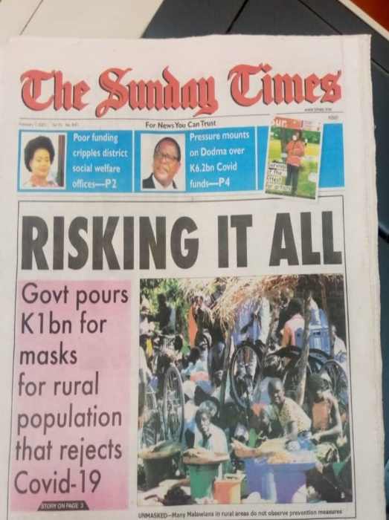
Perceptions about COVID-19
High awareness levels
Many reported following preventive guidelines though not collaborated by key informants
COVID-19 perceived as disease for the following people only
  City dwellers
  Rich people
  People that travel by air
  That frequent hotels/conferences
  Senior white-collar workers
Rural masses reject COVID-19
Work of anti-Christ – no worship
Felt immune
  due to hard manual work
  organic foods in their diets
www.future-agricultures.org/apra
Notes:
People felt immune to COVID-19 due to the hard manual work that they do and the local organic foods that dominate their meals
Face masks cause COVID-19, breathing problems and is evidence of being infected

Slide 5
Perceptions about COVID-19
Access to health services did not change but key informants revealed that people were shunning hospitals and medical workers
  Afraid of contracting COVID-19/ being falsely declared positive, and risk being placed under isolation.
  Some medical workers beaten up – accused of falsely diagnosing people as positive and declaring normal deaths as COVID deaths
  Misconception that medical workers are being paid huge sums of money for every COVID-19 case or death recorded
Low uptake of COVID-19 vaccines and initial stock expired, worse in rural areas
  Vaccines linked to satanism (666), poison to kill high population of black people, and cause people to become sexually impotent & infertile
  Political & high-profile people accused of getting special vaccines which are safe
www.future-agricultures.org/apra

Slide 6
Activities by children
Only a third were doing school-work at home, with increases in household chores for girls and farm work for boys. More sexual activities for teens and teenage pregnancies
www.future-agricultures.org/apra
Notes:
Closure of schools resulted in reduced learning for children.
..most households can therefore afford to forego hired labour. – Extension coordinator, Nthisi, October 2021
(R1 -June/July marketing period, R2 –Oct pre-planting period, & R3 - Feb Lean period)

Slide 7
Movement restrictions due to COVID-19
General reduction in movements - in and outside villages
R2, households relaxed; consistent with low prevalence of COVID at the national level and misconception that they are less vulnerable to the disease
www.future-agricultures.org/apra
Notes:
Partly due to increases in transport costs due to reduced vehicle seating capacity
(R1 -June/July marketing period, R2 –Oct pre-planting period, & R3 - Feb Lean period)

Slide 8
Modes of payment for transactions
Mobile payments remain widely unused
Increased from 17% in R1 and R2 to 33% in R3.
Why are mobile payments rarely used?
Cash is the dominant means of exchange here. People would love to use mobile money services but being poor as most of the households are in this community, they find the transaction charges to be a waste of their money. Perhaps all service charges could have been suspended. And phone signal too can be very unreliable here….Extension worker, Mchinji, February 2021
www.future-agricultures.org/apra
Notes:
(R1 -June/July marketing period, R2 –Oct pre-planting period, & R3 - Feb Lean period)

Slide 9
Social Assistance amid COVID-19
Majority (60% of respondents) did not receive any assistance
Government only reached out to 30% of respondents with COVID-19 social assistance though key informants revealed this was continuation of pre-COVID work
…the only assistance I am aware of is that of handwashing facilities that have been distributed to schools, markets, and district council offices. I hear the government is planning cash transfers targeting poor households in the cities alone. Traditional chief, Ntchisi, June 2020
www.future-agricultures.org/apra

Slide 10
Farming and business livelihood changes
Largely no reported changes in farming activities
Business enterprise activities reduced
Crop marketing most affected ( due to reduced ability to sale produce, scarcity of traders, increased transport costs, boarder closures)
www.future-agricultures.org/apra
Notes:
R1 -June/July marketing period, R2 –Oct pre-planting period, & R3 - Feb Lean period
KII observed that rural life continued as normal with minimal disruption
Most cases & deaths related to COVID-19 happened in urban areas and the major cities
Boarder closures meant limited informal export trade (Mchinji with Zambia and Ntchisi with Tanzania)

Slide 11
Farming and Business Livelihood Changes
Threats to food security as expressed:
…COVID-19 necessitated border closures, blocking the Zambian traders from crossing into Malawi. Farmers could only sale to local vendors at very low prices. To meet their usual income needs, they had to sell more produce than normal.
– NASFAM official, Mchinji, February 2021.
…low produce prices forced farmers to sell most of their food harvests to raise a meaningful income. This is what will cause hunger among farmers. – Extension coordinator, Ntchisi, October 2021
www.future-agricultures.org/apra
Notes:
Much as farming activities were not disrupted, neither irrigation farming- the threats to food insecurity are because households sold most of what they produced

Slide 12
Farming and Business Livelihood Changes
Prices of vegetables that are perceived to have medicinal values skyrocketed to the benefit of farmers – garlic, ginger, onions, lemons
Challenges with off-farm employment opportunities as school closures provided HHs with extra family labour
…those that survive by hiring out their labour are finding it increasingly hard to get hired and are accepting even less wages. – Extension coordinator, Nthisi, October 2021
Escalating costs of land rentals, limited access to extension workers, credit was also found
www.future-agricultures.org/apra
Notes:
Efforts to promote e-extension in Ntchisi faced challenges of lack of phones, poor network, low levels of literacy and unaffordability of airtime

Slide 13
Food and nutrition security
Over 70% worried about having inadequate food, unable to eat healthy foods, ate only few kinds of food, ate less.
Increase in proportion skipping meals from 57% in R1 (during the marketing period) to 77% in R2 (during the pre-planting period), and to 76% in R3 (during the lean period).
About 30% went without eating for whole day in each Round
Grain prices increased in R3 for 60% of respondents
www.future-agricultures.org/apra
Notes:
R1 -June/July marketing period, R2 –Oct pre-planting period, & R3 - Feb Lean period

Slide 14
Perceived Poverty
Many households placed themselves on the bottom steps of the ladder- no changes with COVID
At least half of the respondents reported about rise in the cost of living
Households reporting able to control their lives drastically declined, suggesting increasing difficulty in living conditions
www.future-agricultures.org/apra
Notes:
R1 -June/July marketing period, R2 –Oct pre-planting period, & R3 - Feb Lean period

Slide 15
Conclusion
Lower number of children were doing schoolwork at home (less so for girls), with likely repercussions on learning
Extended closure of schools have seen girls and boys engage more in risky behaviours; becoming pregnant, getting married and dropping out of school, local drug & substance abuse – need specific strategies for the youth (e.g. sexual and reproductive health education)
Gender differences in division of work perpetuating perceptions about what girls & boys can/cannot do
www.future-agricultures.org/apra
Notes:
call for more fairness///equity
affecting conduct of school work at hoke as well

Slide 16
Conclusion
Farming activities are unaffected but rising cost of inputs, unavailability of extension services likely to affect productivity
Explore ICT for extension delivery and payment for transactions
Farm & Off-farm work are difficult to find; no COVID-19 related social assistance, those subsisting by offering their labour for ganyu cant find work – what would be the role of social protection amid COVID-19; how do we cushion livelihoods?
www.future-agricultures.org/apra
Notes:
call for more fairness///equity

Slide 17
Conclusion
Access to health services did not change in the study period but misconceptions about COVID-19 reducing health seeking behaviour
Lots of misconceptions and fake news around COVID-19 in the study districts and across Malawi – on causes, who is vulnerable, who is immune, roles of medical workers, vaccines – calls for strong & sustained social and behaviour change communication
www.future-agricultures.org/apra

Slide 18
Resources on our COVID-19 research
COVID Impact : https://www.future-agricultures.org/covid-19/#apra_publications
https://www.future-agricultures.org/impact-assessment/impact-of-covid-19-on-food-systems-and-rural-livelihoods-in-malawi-round-2-report/
https://www.future-agricultures.org/blog/perceptions-and-misconceptions-of-smallholder-farmers-of-covid-19-in-central-malawi/
https://www.future-agricultures.org/news/online-covid-19-poverty-informing-economic-and-social-policy-in-malawi/
www.future-agricultures.org/apra

Slide 19
Rapid Assessment of the Impact of COVID-19 on Food Systems and Rural Livelihoods in Malawi
by
Mirriam Matita & Masautso Chimombo
(APRA Researchers Malawi)
11th November 2021
Funded by UK aid from the UK Government
www.future-agricultures.org/apra

